Slide 1
Express Framework Overview
Nguyễn Viết Mạnh – DU10 – TOBA’s member

Slide 2
Content
Introduction to Express JS
What is Express JS ?
The need for Express JS
Features of Express JS
Advantages/Disadvantages of Express JS
Companies using Express JS
Demo mini-code Express JS

Slide 3
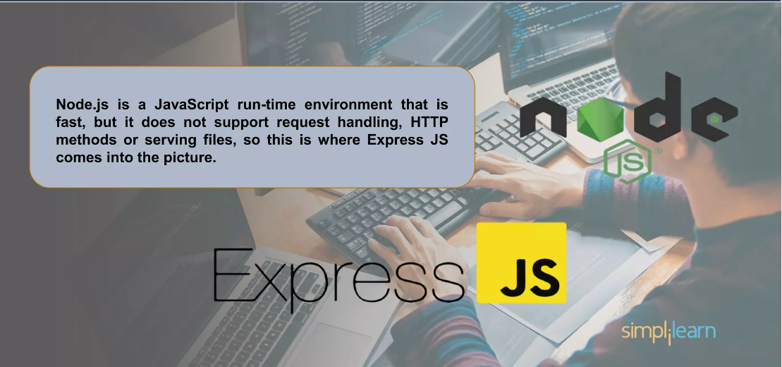
Introduction to Express JS

Slide 4
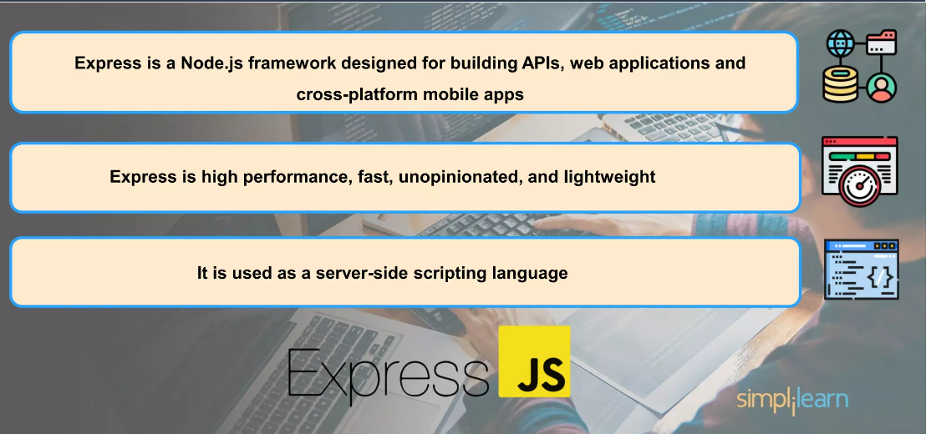
2. What is Express JS ?

Slide 5

3. The need for Express JS

Slide 6
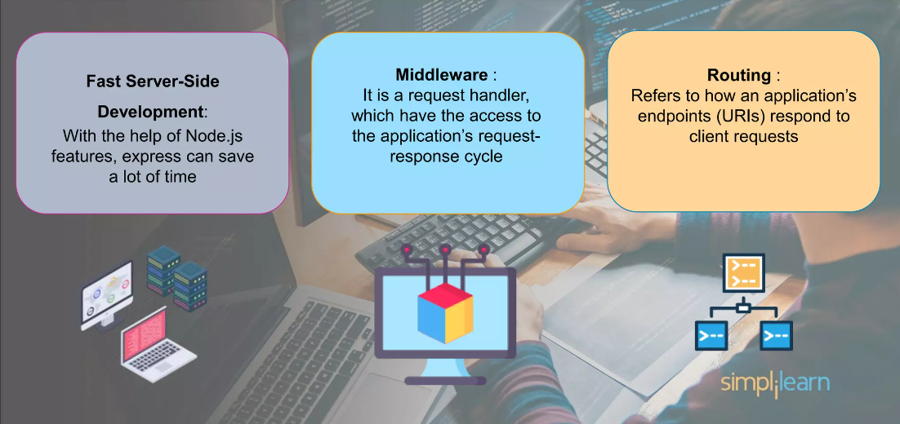
4. Features of Express JS

Slide 7
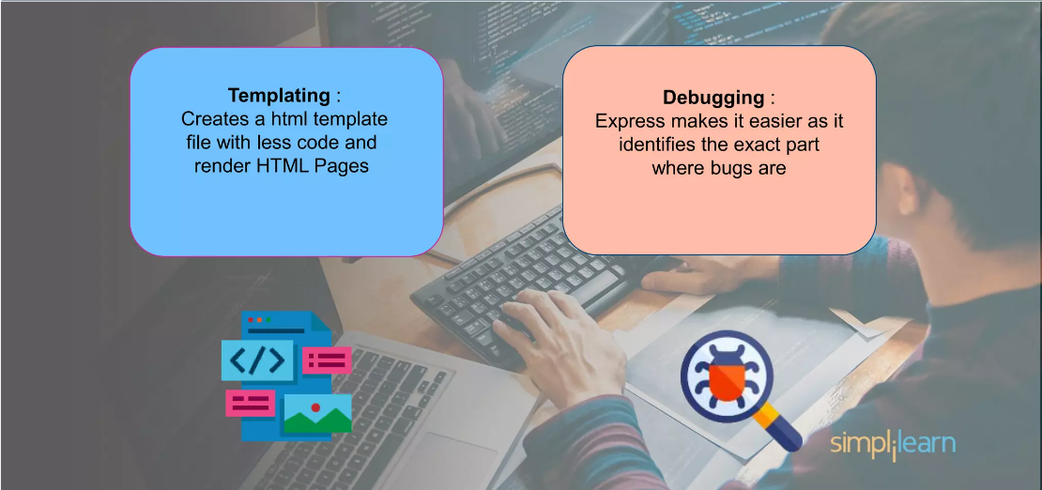
4. Features of Express JS

Slide 8
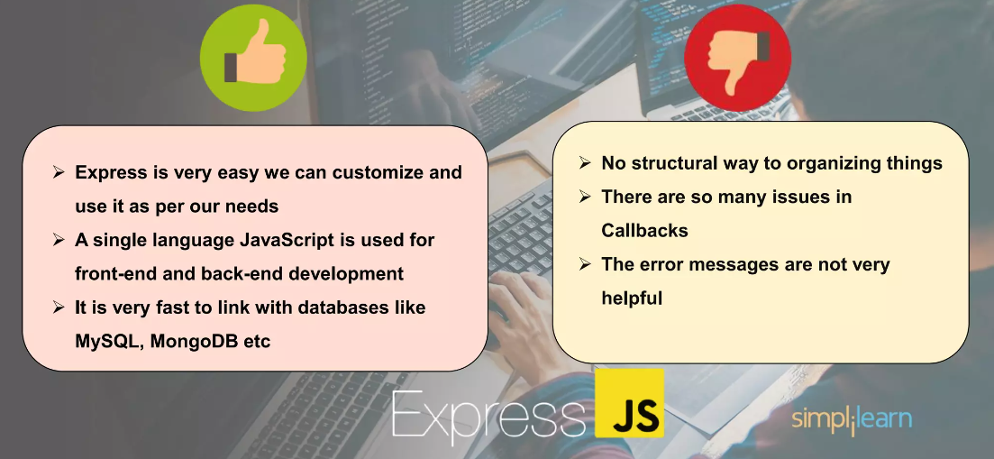
5. Advantages/Disadvantages of Express JS

Slide 9
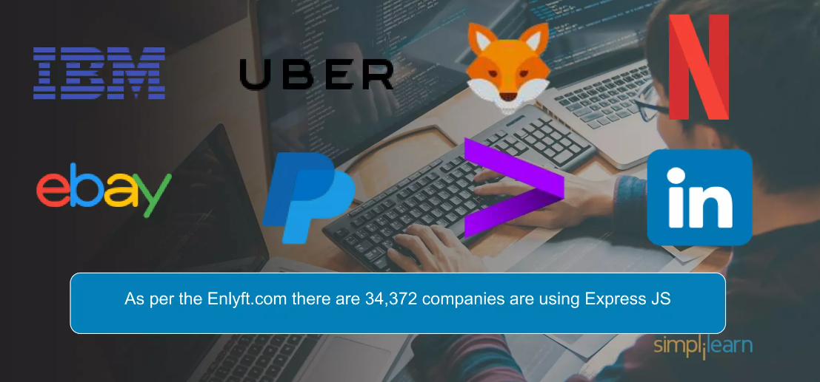
6. Companies using Express JS

Slide 10
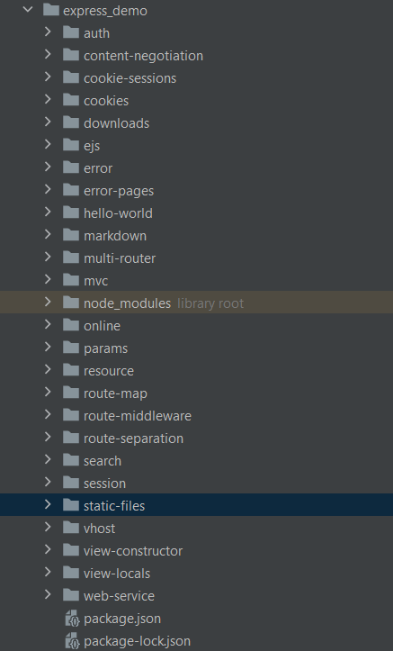
7. Demo mini-code Express JS

Slide 11


